Slide 1
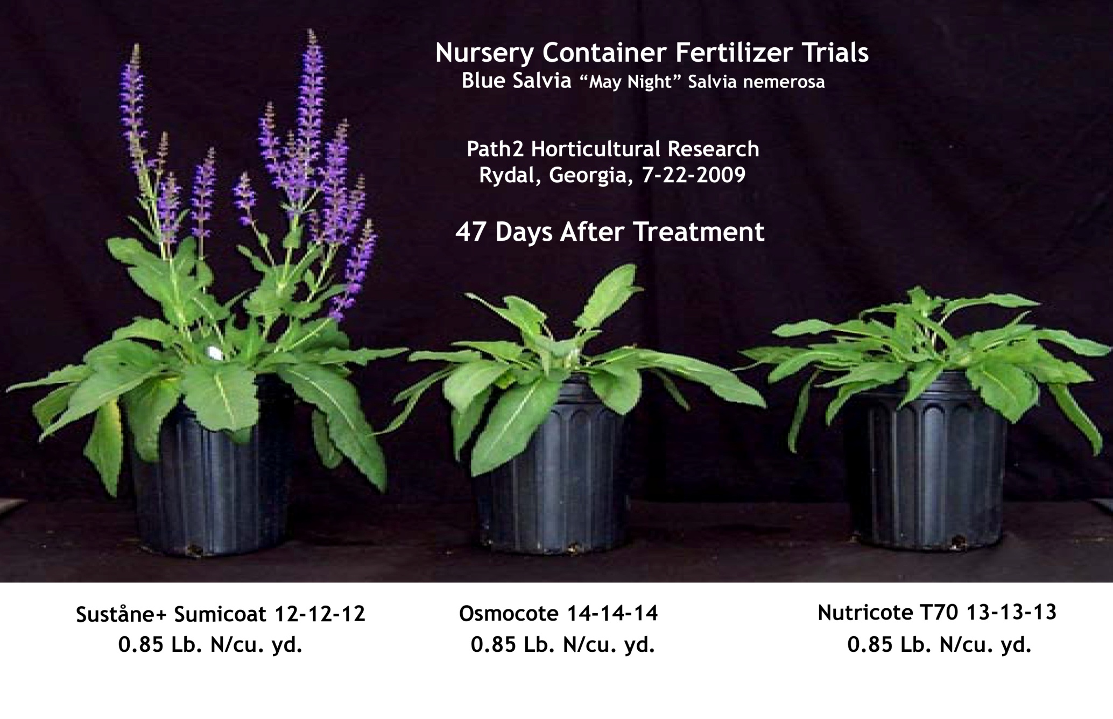
Identical Fertilizer Rates: Suståne vs. Industry Standards Salvia 47 DAT

